Slide 1



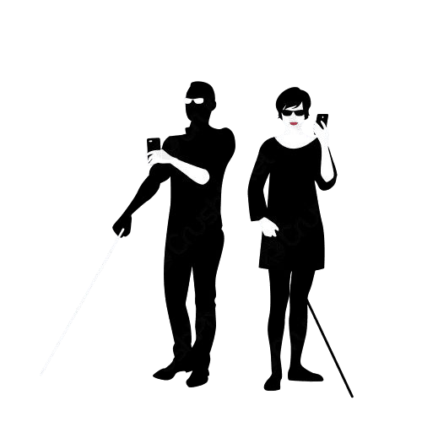
Assiut University
Faculty of Computers and Information
Application to Help the Blind
(Eyes Mate)
Graduation Project Academic Year 2023-2024
Team Members :
Islam Abdel_Hady Hassanein (CS)
Enas Ragab Abdel_Latif (CS)
Mariam Tarek Saad (CS)
Rawan Mohammed Ahmed (IS)
Supervisor Dr. Abdel_Rahman Hedr

Slide 2


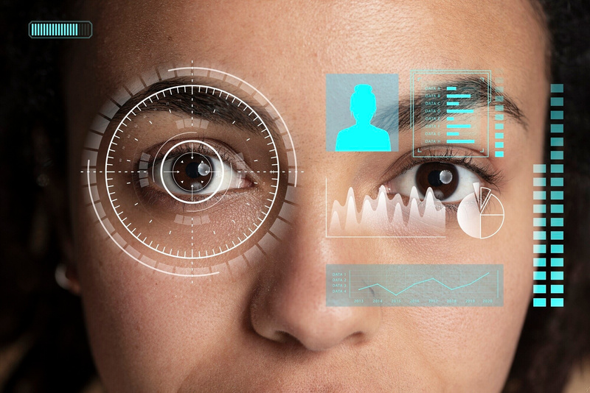
Introduction
Main Problem Blind individuals face a number of challenges that significantly impact their daily lives and independence. One of the primary challenges is identifying objects in their surroundings. This struggle makes it difficult to perform everyday tasks, such as locating household items, recognizing street signs, and distinguishing between different products in stores. Furthermore, reading printed text on packages, books, or signs is nearly impossible without assistance, limiting access to critical information, including instructions, warnings, and other written communications.
Navigating indoor and outdoor environments safely is another major concern. Without the ability to measure distances or detect obstacles, blind individuals are at risk of collisions and accidents, making it difficult to move around confidently. Social interactions also pose significant challenges, as facial recognition is essential for meaningful engagement. Blind individuals often struggle to identify friends, family members, or colleagues, making social engagements and group activities difficult.

Slide 3
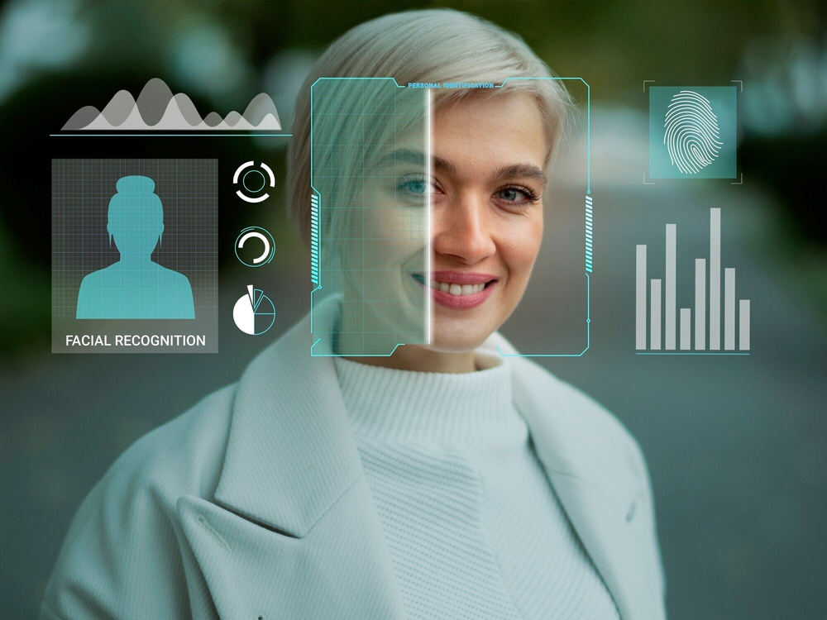
Introduction
In addition, identifying different denominations of currency is a significant challenge, leading to potential financial vulnerabilities and difficulties in conducting transactions independently. Together, these challenges severely limit the independence, mobility, and quality of life of blind and low-vision individuals, highlighting the urgent need for innovative solutions to address these pressing needs.
Our Solution:
We are developing a mobile application that leverages machine learning to assist the blind in their daily lives. By using the mobile phone’s camera, our application captures images or videos of the surrounding environment and uses advanced machine learning algorithms to identify and describe objects, read text, and recognize faces. This information is then converted into audio and played back to the user. Additionally, the application can measure distances to help users navigate safely and recognize the number of people in social settings. Personalization features, such as facial recognition of friends and relatives, enhance the user experience and provide real-time alerts and notifications. Our goal is to create a reliable, user-friendly application that significantly improves the independence and quality of life for blind individuals.

Slide 4

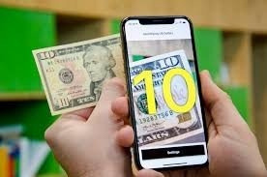
Analysis of the Problem: Challenges Faced by Blind Individuals in Navigating Daily Life
Problem Overview Blind and visually impaired individuals face numerous challenges in their daily lives, primarily due to their inability to see their surroundings. These challenges impact their independence, safety, and social interactions. The key problems include difficulty in identifying objects, reading text, recognizing faces, measuring distances, and navigating through different environments. These issues not only hinder their day-to-day activities but also affect their overall quality of life.

Slide 5

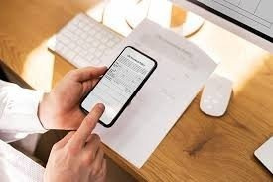
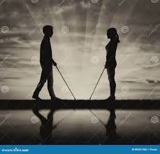
Key Challenges
1. Object Identification:
Blind individuals often struggle to identify objects in their surroundings,
which can lead to difficulties in performing everyday tasks such as cooking, cleaning, or shopping.
The lack of visual information can result in accidental injuries or the inability to locate essential items.
2. Reading Text:
Access to printed text, such as books, labels, and signs, is a significant challenge for the blind.
This limitation affects their ability to read instructions, product details, and other important information that sighted individuals take for granted.
3. Facial Recognition:
Recognizing people, especially in social settings, is a critical challenge for blind individuals.
The inability to identify faces can lead to social isolation and difficulty in building and maintaining relationships.
4. Distance Measurement:
Blind individuals cannot accurately gauge distances to objects, which affects their ability to navigate safely in various environments.
This challenge is particularly pronounced in unfamiliar or crowded spaces, increasing the risk of collisions and accidents.
5. Environmental Navigation:
Navigating both indoor and outdoor environments is a significant challenge without visual cues.
Obstacles, changes in terrain, and lack of directional information make it difficult for blind individuals to move independently and confidently.
6. Social Interaction:
The inability to perceive non-verbal cues, such as gestures and facial expressions, hampers effective communication and social interactions.
Blind individuals may miss out on important social signals, leading to misunderstandings and feelings of isolation.

Slide 6

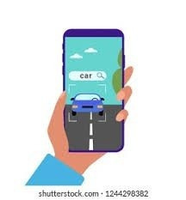
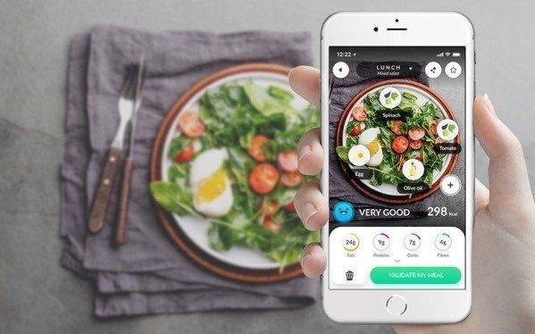
Existing Solutions and Their Limitations
Guide Dogs:
While guide dogs provide valuable assistance, they require significant training and maintenance.
Not all blind individuals have access to or can afford a guide dog.
2. White Canes:
White canes are useful for detecting obstacles but provide limited information about the environment.
They do not assist with object identification, reading text, or recognizing faces.
3. Human Assistance:
Reliance on human guides restricts the independence of blind individuals.
Constant dependence on others is not always feasible and can be intrusive.
4. Existing Assistive Technologies:
Current technologies, such as screen readers and Braille displays, address some issues but do not offer comprehensive solutions for real-world navigation and interaction.
Many existing solutions are expensive, complex to use, or lack real-time capabilities..

Slide 7


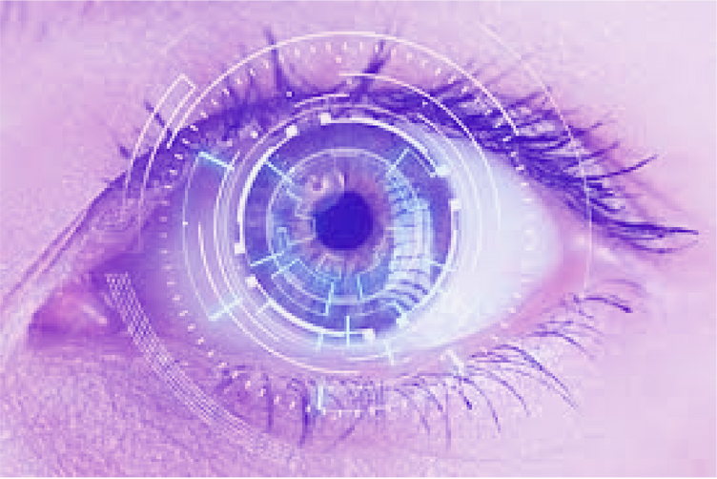
Need for an Integrated Solution
Given the limitations of existing solutions, there is a clear need for an integrated assistive technology that can address multiple challenges faced by blind individuals. Such a solution should:
1. Provide Real-time Object Recognition and Description: Use advanced machine learning algorithms to identify and describe objects, text, faces, and other elements in real-time.
2. Enable Audio Feedback : Convert visual information into audio descriptions that are clear, concise,and easy to understand.
3. Support Distance Measurement and Navigation: Accurately measure distances to help blind individuals navigate safely and avoid obstacles.
4. Enhance Social Interaction: Recognize faces and the presence of people to facilitate social
engagement and reduce feelings of isolation.
5. Provide Real-time Object Recognition and Description: Use advanced machine learning algorithms to identify and describe objects, text, faces, and other elements in real-time.
6. Prioritize Security and Privacy: Implement robust security measures to protect user data, especially in facial recognition and personalization features.

Slide 8


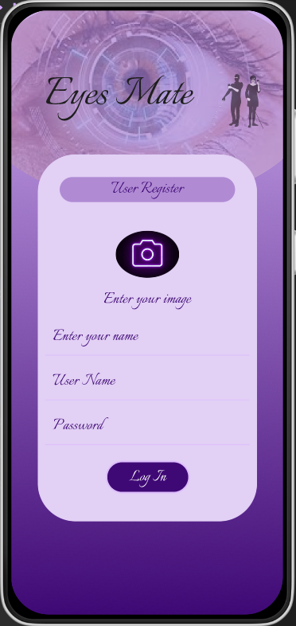
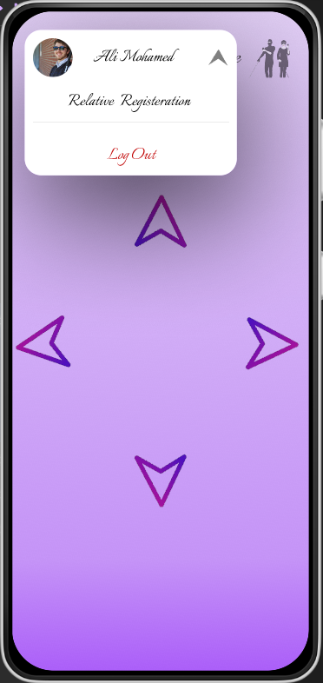
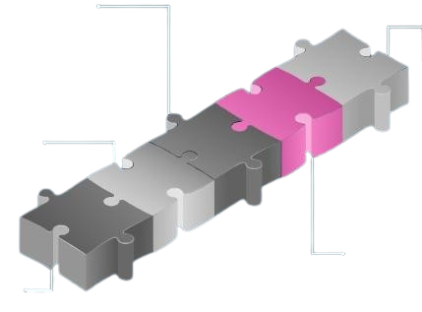
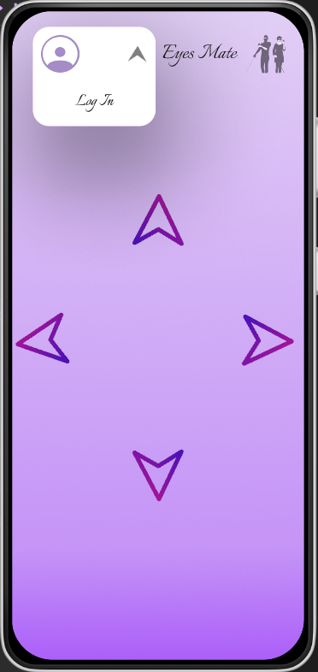
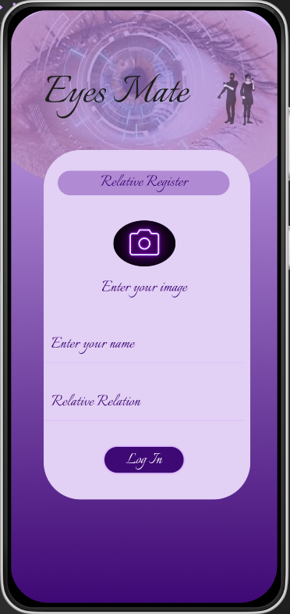
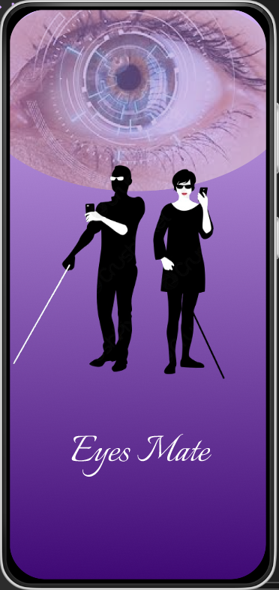
User Interface

Slide 9
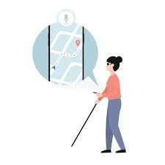
Implementation
Development Environment
Tools and Technologies
Programming Language: Dart for Flutter, Python for Machine Learning Models
Frameworks: TensorFlow, TensorFlow Lite for Flutter, PyTorch, scikit-learn, OpenCV, YOLOv5, Flask
Development Tools: Visual Studio Code (with Flutter and Dart plugins), Jupyter Notebook, Git for version control
Collaboration Tools: Jira, Asana for project management; Slack, Microsoft Teams for communication
Setup and Configuration Details the setup and configuration processes for the development environment, ensuring all tools and technologies are correctly installed and configured.
Code Structure
Module Breakdown:
Object Recognition Module: Handles object detection and distance measurement
Text Reading Module: Manages text recognition and conversion to audio
Currency Recognition Module: Identifies different currencies
Facial Recognition Module: Recognizes and identifies faces, counting persons and providing real-time alerts

Slide 10
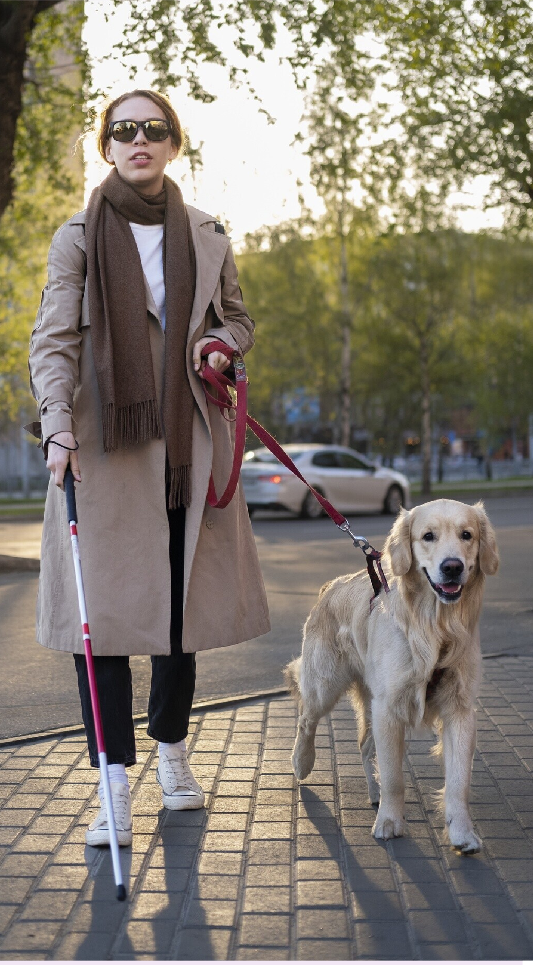
Implementation Details
Object Recognition Module:
YOLOv5 Algorithm: Used for real-time object detection, capturing images via the mobile camera and identifying objects.
Distance Measurement: Calculates distances to objects using image data.
Text Reading Module:
OCR (Optical Character Recognition): Reads text from images.
Text-to-Speech (TTS): Converts recognized text into audio.
Currency Recognition Module:
CNN (Convolutional Neural Network): Identifies different types of currency using pre-trained models.
Transfer Learning: Enhances the model's accuracy using MobileNetV2.
Facial Recognition Module:
MTCNN (Multi-task Cascaded Convolutional Networks): Detects and recognizes faces.
Person Counting: Counts the number of people detected in the image.

Slide 11
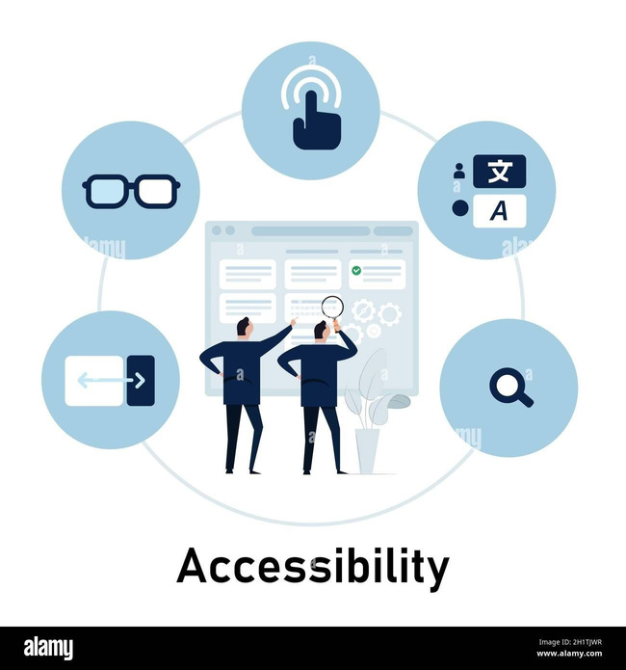
Testing
Introduction:
Objective: Verify functionality, usability, performance, security, and compatibility.
Testing Objectives:
Functionality: Ensure features work as specified.
Usability: Confirm user-friendliness for blind users.
Performance: Assess real-world performance.
Security: Protect user data.
Compatibility: Verify smooth operation across devices and OS.
Testing Tools and Environment:
Manual Testing: QA team and end-users.
Devices: Various Android and iOS devices.
Environment: Visual Studio Code, Jupyter Notebook.
Test Cases and Results:
Object Recognition: Successful in varied lighting.
Audio Conversion: Clear audio playback.
Distance Measurement: Accurate within range.
Face Recognition: Correct identification and notifications.
Usability: Intuitive navigation.
Performance: Responsive under load.
Bug Tracking and Resolution:
Identification: Detailed reports.
Prioritization: Based on impact.
Fixing: Addressed and retested.
Verification: QA team and user feedback
Testing Summary:
Confirmed application’s reliability, security, and usability.
Positive UAT feedback

Slide 12


Demo

